Slide 1

Machine Learning

Slide 2
Deep Learning
Using neural networks in a machine learning model
Can require more data/ computation to train than ML models we have seen so far
No feature engineering required: neural network parameters can capture high level information without as much user input

Slide 3
Neural Networks
Graphs of interconnected neurons that flow from one end to another

Slide 4
Neural Networks
Layers:
Input
Hidden
Output

Slide 5
Neural Networks
Creating more layers creates more tunable parameters, often increasing performance. However, this decreases interpretability.

Slide 6
What does a single Neural Network Layer do?
F( Wx + b )

Slide 7
What does a single Neural Network Layer do?
x₁
F( Wx + b )
x₂
x₃

Slide 8
What does a single Neural Network Layer do?
x₁
F( Wx + b )
x₂
x₃

Slide 9
What does a single Neural Network Layer do?
x₁
F( Wx + b )
x₂
x₃

Slide 10
What does a single Neural Network Layer do?
F( Wx + b )

Slide 11
What does a single Neural Network Layer do?
W
x
Wx
2 | 4 | 2
1 | 3 | 7
0 | 7 | 3
1
3
2
18
24
27

Slide 12
What does a single Neural Network Layer do?
Wx
b
18
24
27
-3
0
2
+

Slide 13
What does a single Neural Network Layer do?
18
24
27
-3
0
2
F
+

Slide 14
What does a single Neural Network Layer do
18
24
27
-3
0
2
F
+
Activation Function

Slide 15
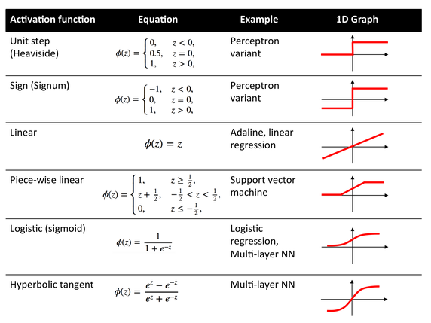
https://en.wikipedia.org/wiki/Activation_function

Slide 16
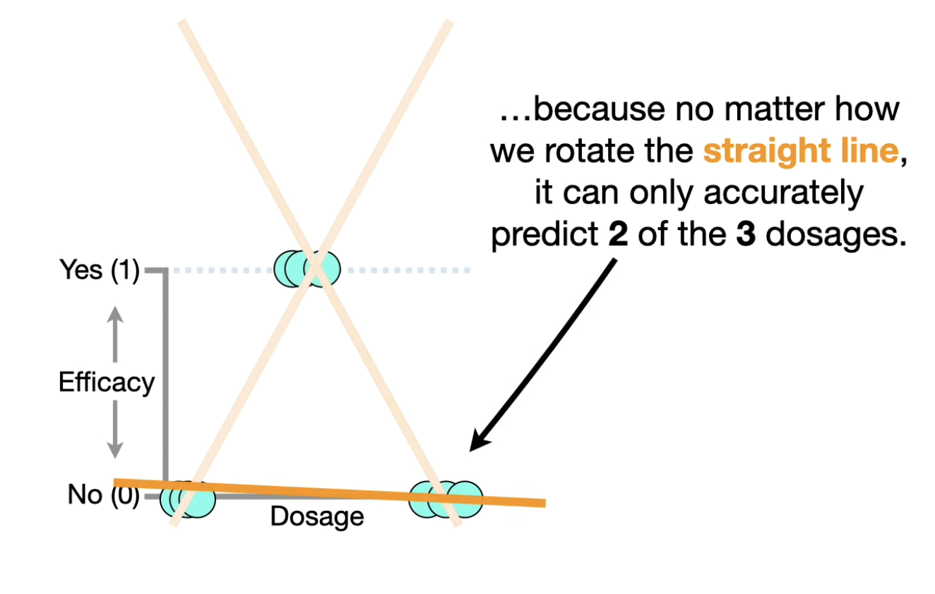

Slide 17
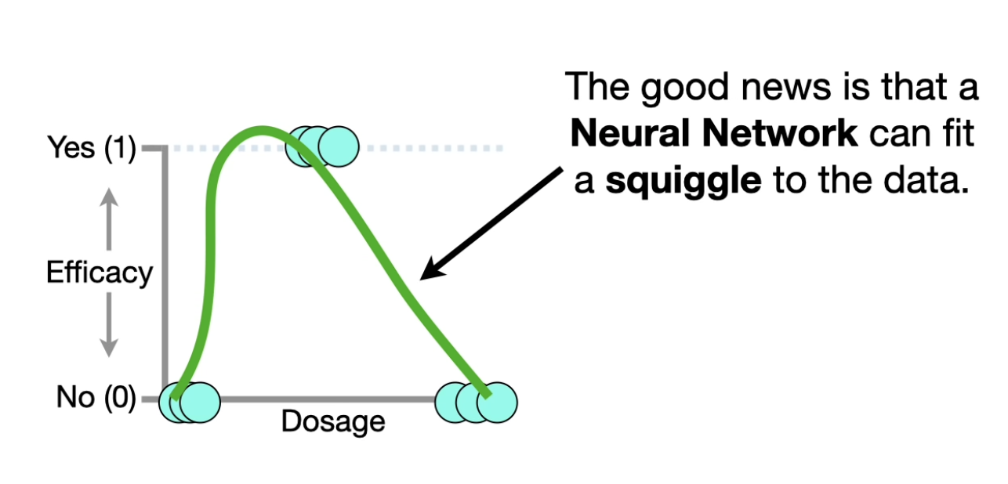

Slide 18
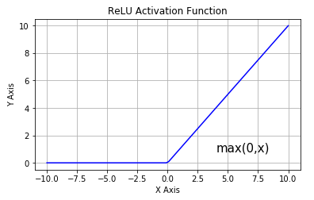
ReLU Activation function
It stands for Rectified Linear Unit
ReLU(x) = max(x,0)

Slide 19
What does a single Neural Network Layer do?
18
24
27
-3
0
2
F(15)
F(24)
F(29)
F
+

Slide 20
What does a single Neural Network Layer do?
2 | 4 | 2
1 | 3 | 7
0 | 7 | 3
1
3
2
-3
0
2
F
+

Slide 21
What does a single Neural Network Layer do ?
2 | 4 | 2
1 | 3 | 7
0 | 7 | 3
1
3
2
-3
0
2
F
+
Weight Matrix

Slide 22
What does a single Neural Network Layer do ?
2 | 4 | 2
1 | 3 | 7
0 | 7 | 3
1
3
2
-3
0
2
F
+
Input Vector

Slide 23
What does a single Neural Network Layer do ?
2 | 4 | 2
1 | 3 | 7
0 | 7 | 3
1
3
2
-3
0
2
F
+
Bias Vector

Slide 24
What does a single Neural Network Layer do ?
2 | 4 | 2
1 | 3 | 7
0 | 7 | 3
1
3
2
-3
0
2
F
+
Trainable Parameters

Slide 25
What does a single Neural Network Layer do ?
F( Wx + b )

Slide 26
What does a single Neuron do ?
F( w₁^{T}x + b₁ )

Slide 27
What does a single Neural Network Layer do ?
F( Wx + b )

Slide 28
Weights for each neuron
2 | 4 | 2
1 | 3 | 7
0 | 7 | 3
w₁^{T}
w₂^{T}
w₃^{T}
W =
=

Slide 29
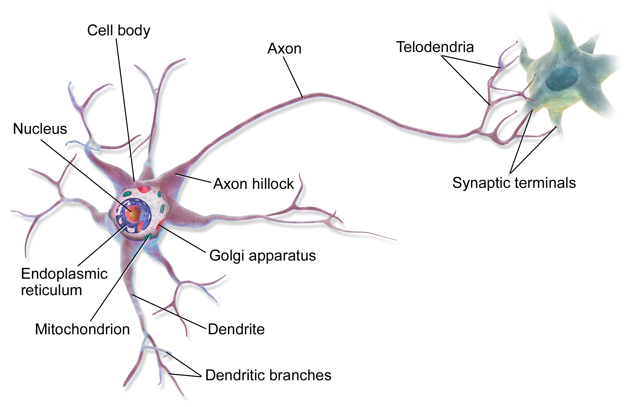
Why does it call Neuron?
F( w₁^{T}x + b₁ )
Playground

Slide 30
Stacking multiple layers
It’s called a deep neural network when you use multiple layers

Slide 31
What are the inputs and outputs?

Slide 32
What does the Hidden Layer do?
Adds complexity
Increases number of trainable parameters
Number of neurons in each hidden layer is also a tunable parameter, as well as number of hidden layers total

Slide 33
How does it “learn”?
Updates parameter values (W and b) based on some loss function
To do this update, we can use Gradient Descent
The loss (or cost) function is how we evaluate what is “good” or “bad” -> goal is to minimize loss

Slide 34

Gradient Descent
The Idea is to go downhill according to the linear approximation of your function
But not too much as your approximation will not be true
This means updating each weight in proportional to the gradient

Slide 35
Gradient Descent
The Idea is to go downhill according to the linear approximation of your function
But not too much as your approximation will not be true
This means updating each weight in proportional to the gradient
Learning Rate

Slide 36
How to compute gradients - Backpropagation
Numerically approximating gradients is too slow and computationally expensive
The neural network is a well defined mathematical function, we should be able to differentiate it and calculate the derivatives
This is also too tedious so we instead use an algorithm called backpropagation

Slide 37
Computational Graph
Consider this simple function, imagine that this is the cost function and we want to find the gradients with respect to the two weights
We will first build the computational graph that this function represents

Slide 38
Computational Graph
x₁
w₁
+
*
x₂
w₂
*
max
x₃

Slide 39
Computational Graph
x₁
*
w₁
+
F
x₂
max
*
x₃
w₂

Slide 40
Forward propagation
Key to remember: Transforming input X through a model with linear and non-linear transformation to get a output.
Each Circle represents a computational operation
Each arrow is an intermediate quantity that is computed
Each box contains some value
Orange boxes are inputs
Blue boxes are parameters
Compute the inputs to an operation first then apply the operation to compute its output

Slide 41
Forward propagation
3
+
7
4

Slide 42
Forward propagation
3
*
12
4

Slide 43
Forward propagation
x₁
2
*
w₁
6
3
+
F
x₂
4
max
1
*
4
-2
x₃
3
w₂
-2

Slide 44
Backward propagation
Key to remember: training networks based on current output and true Y, optimizing parameters to minimize loss
The numbers flow backwards along the arrows
At each arrow the quantity represents the gradient of some final function with respect to the quantity at that arrow

Slide 45



Backward propagation
2
2
3
+
2
7
4

Slide 46
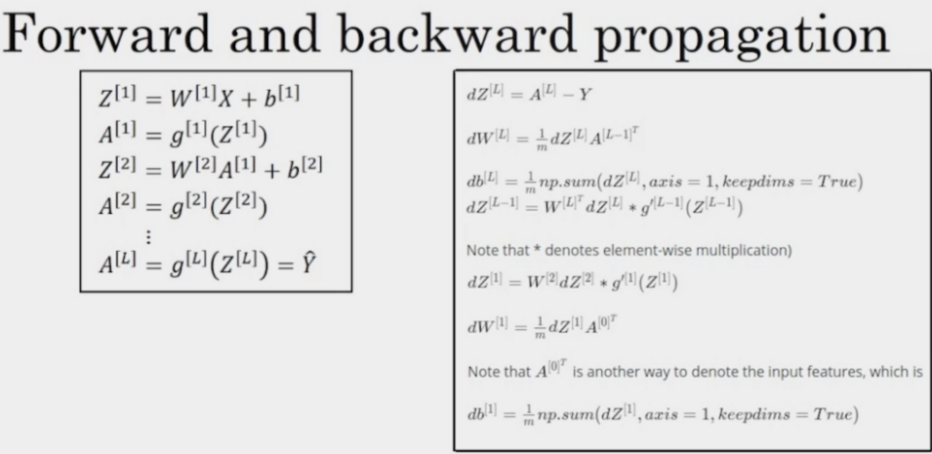
More algorithm in details => CS 230

Slide 47
Forward propagation
x₁
2
*
w₁
6
3
+
F
x₂
4
max
1
*
4
-2
x₃
3
w₂
-2

Slide 48
Backward propagation
3
x₁
2
*
2
1
w₁
6
3
+
1
1
F
x₂
-2
1
4
max
1
*
0
-2
4
1
x₃
3
w₂
-2

